Slide 1
Lecture #11: Neural Network, Back Propagation, and Visualizing the Black Box

Slide 2
ANNOUNCEMENTS
HW5 is due tomorrow (Tues) night at 11:59pm
The Final Exam (individual work) will be posted tonight and is due Monday, Aug. 3. It is cumulative and will be more open-ended.
We will go through a case study in Wednesday’s lecture.
Friday’s lab will go through a little bit more on neural networks, but will mostly be a general review: both conceptual and technical.

Slide 3
Outline
Brief Review of Neural Networks
NN Design choices
Visualizing the Black Box
Back Propagation
Optimization (not covered)
Regularization in NN (not covered)

Slide 4

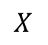


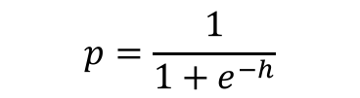
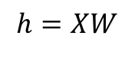
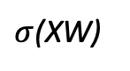
Brief Review of Neural Networks (NNs)
Affine
Activation
Loss Fun
$$ℒ(W)=\sum_{i}^{n}{ℒ_{i}\left(W\right)}$$
$$p=\frac{1}{1+e^{−h}}$$
$$X$$
$$h=XW$$
$$X$$
$σ$(XW)
$$Y$$

Slide 5
Neural Networks : Concept Check
What are the weights in a NN? What are the nodes?
What determines what loss function should be used when designing a NN? What loss function are reasonable to use?
What determines the input and output shapes of a neural network?
What activation function(s) should be considered when creating a NN?
How could a NN be considered as a generalization of stacking?

Slide 6
Anatomy of artificial neural network (ANN)
How many predictors are in this NN? How many hidden layers?
What would the Keras architecture look like?

Slide 7
Design Choices: Architecture

Slide 8
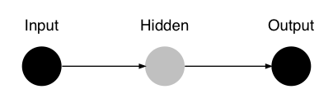
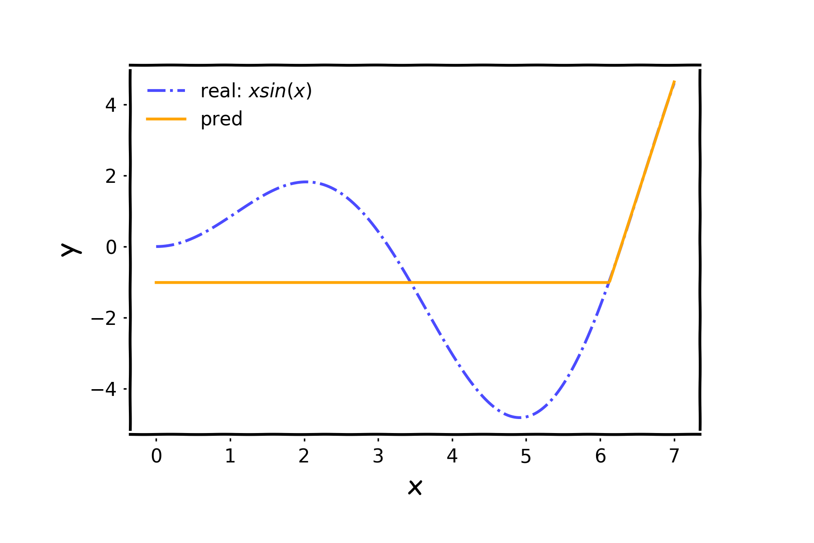
NN in action

Slide 9
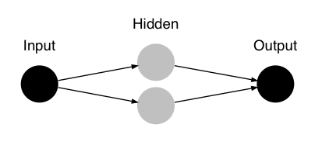
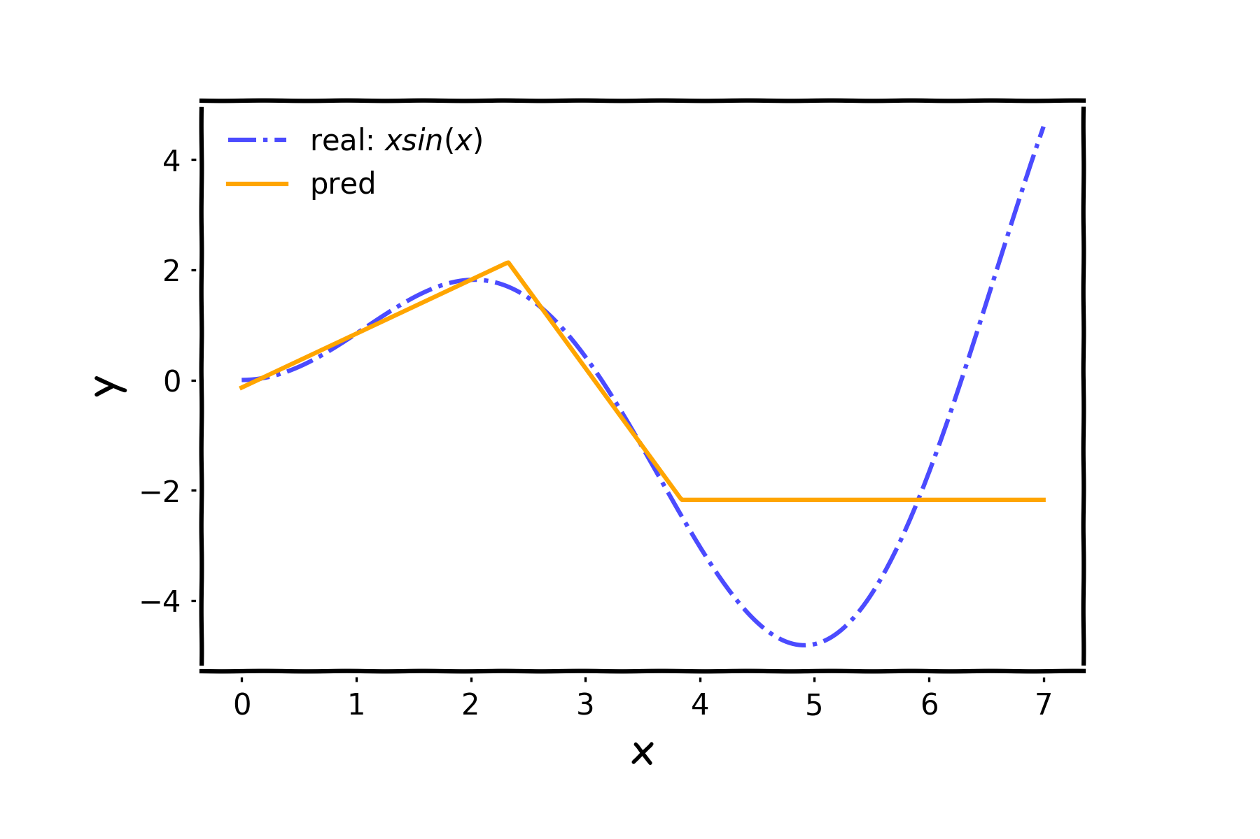
NN in action

Slide 10
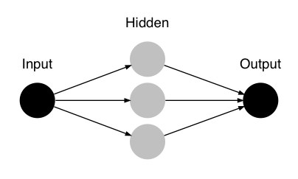
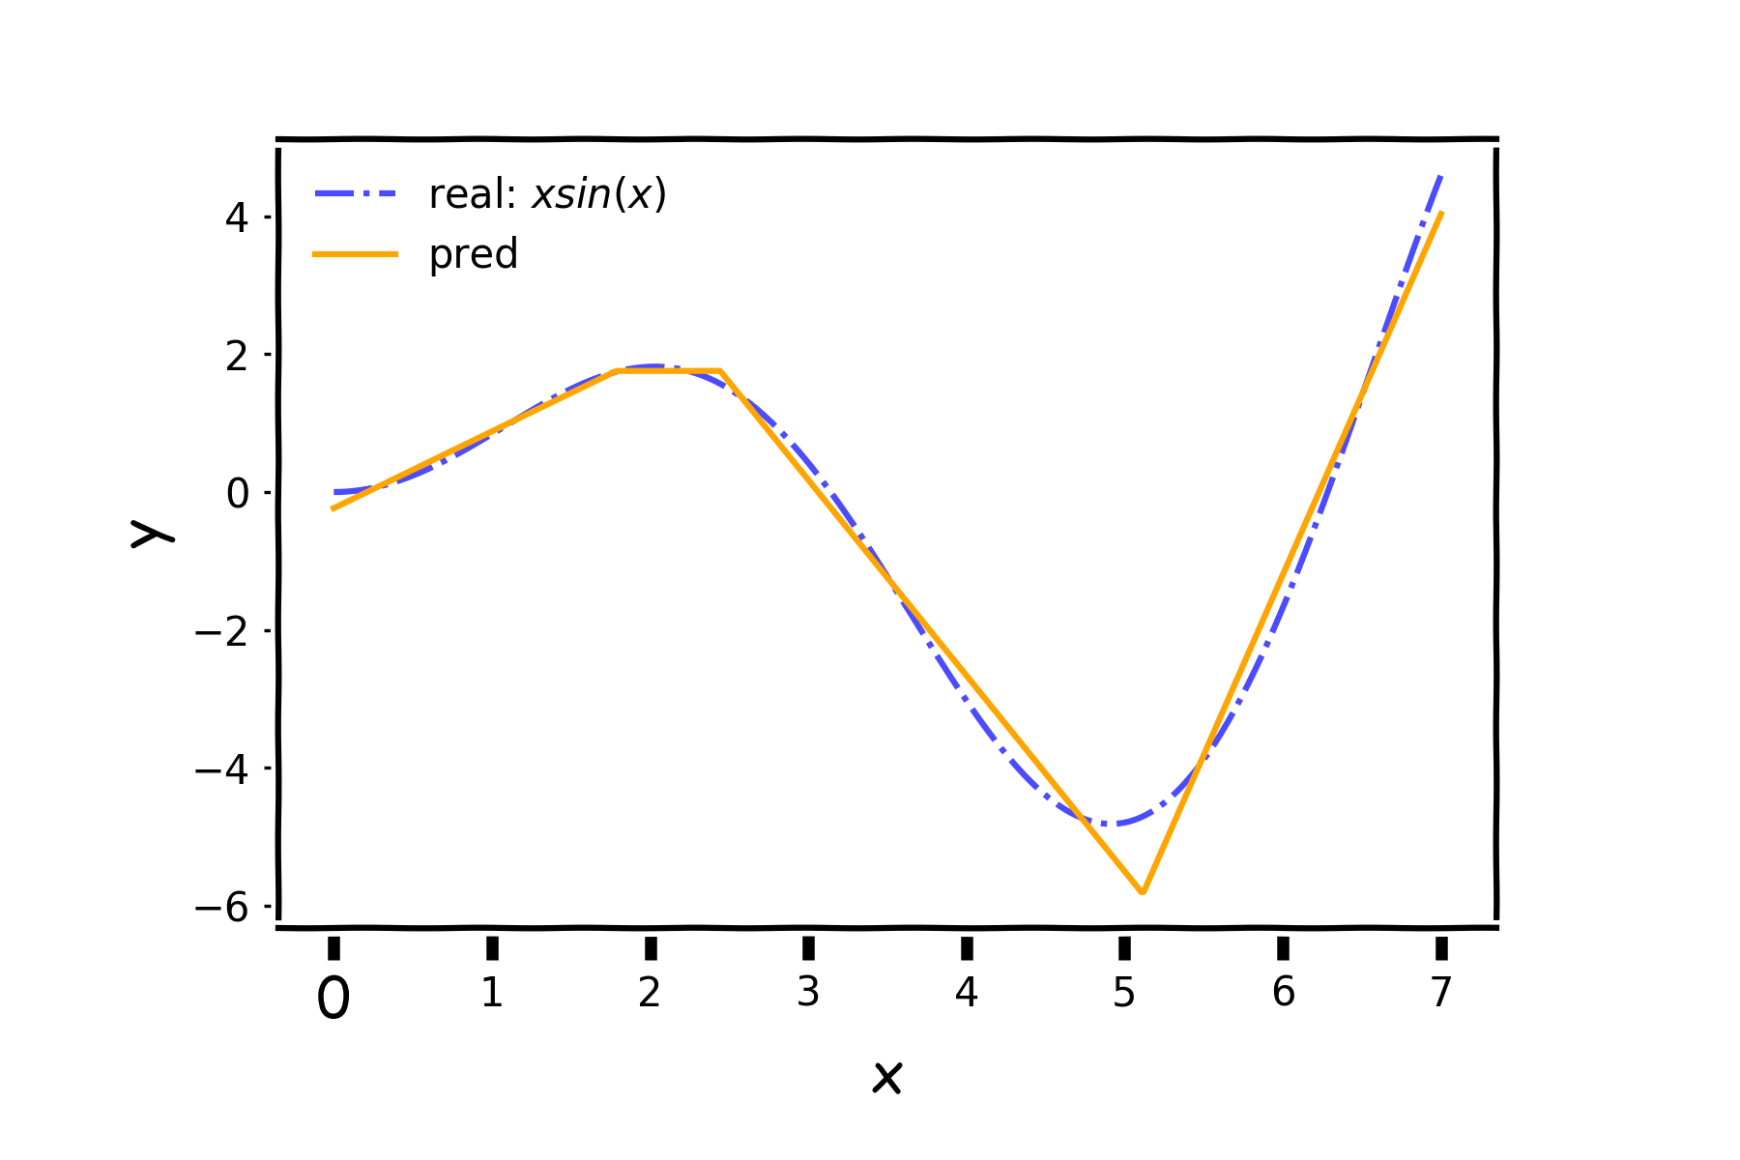
NN in action

Slide 11
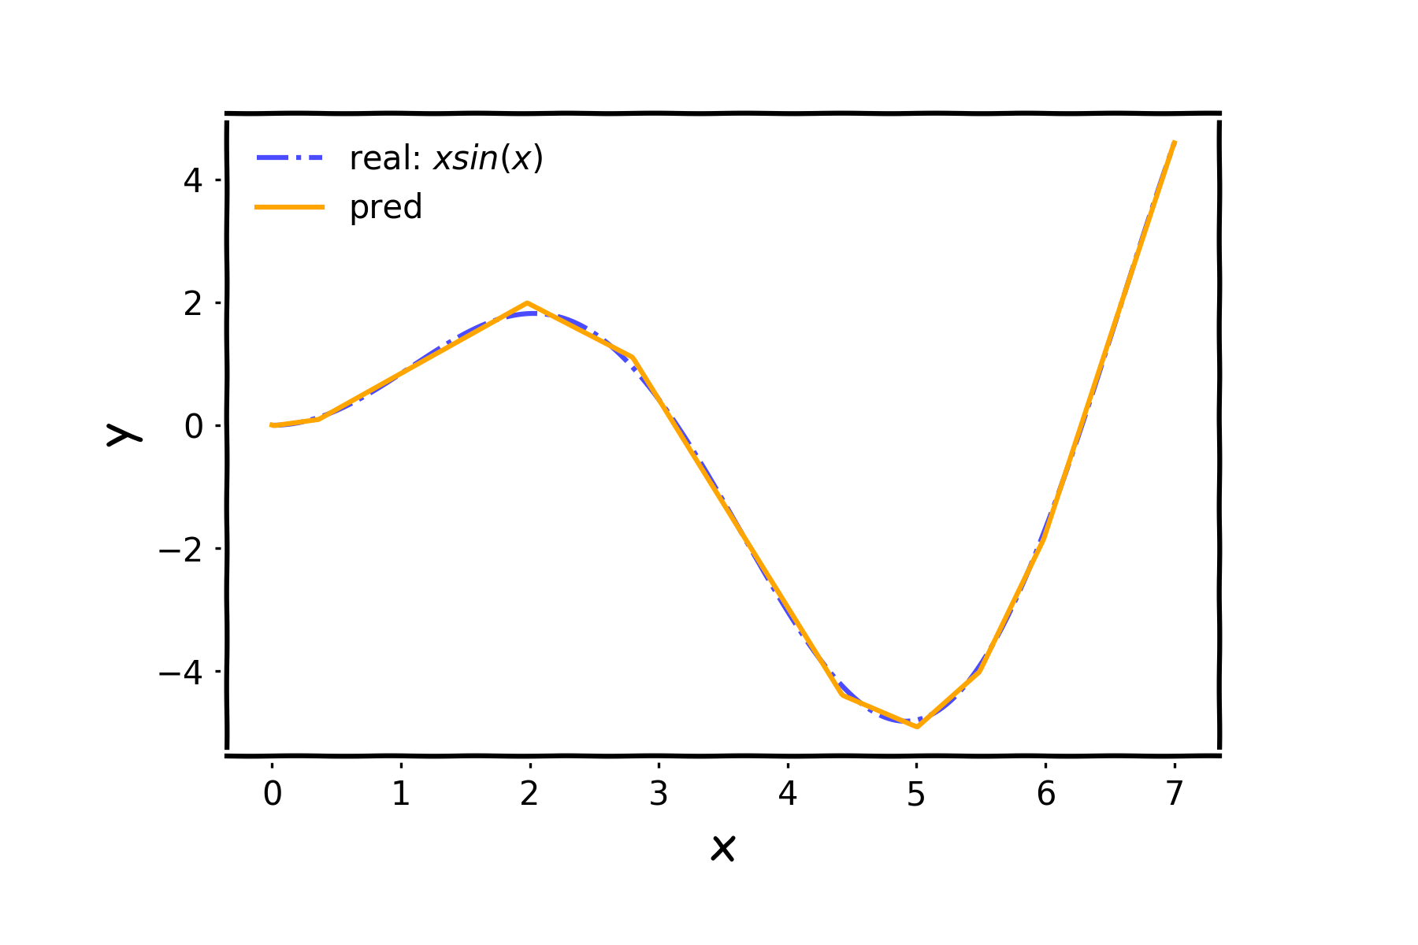
NN in action
…

Slide 12
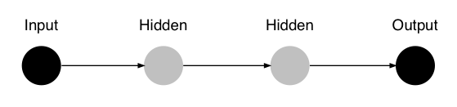
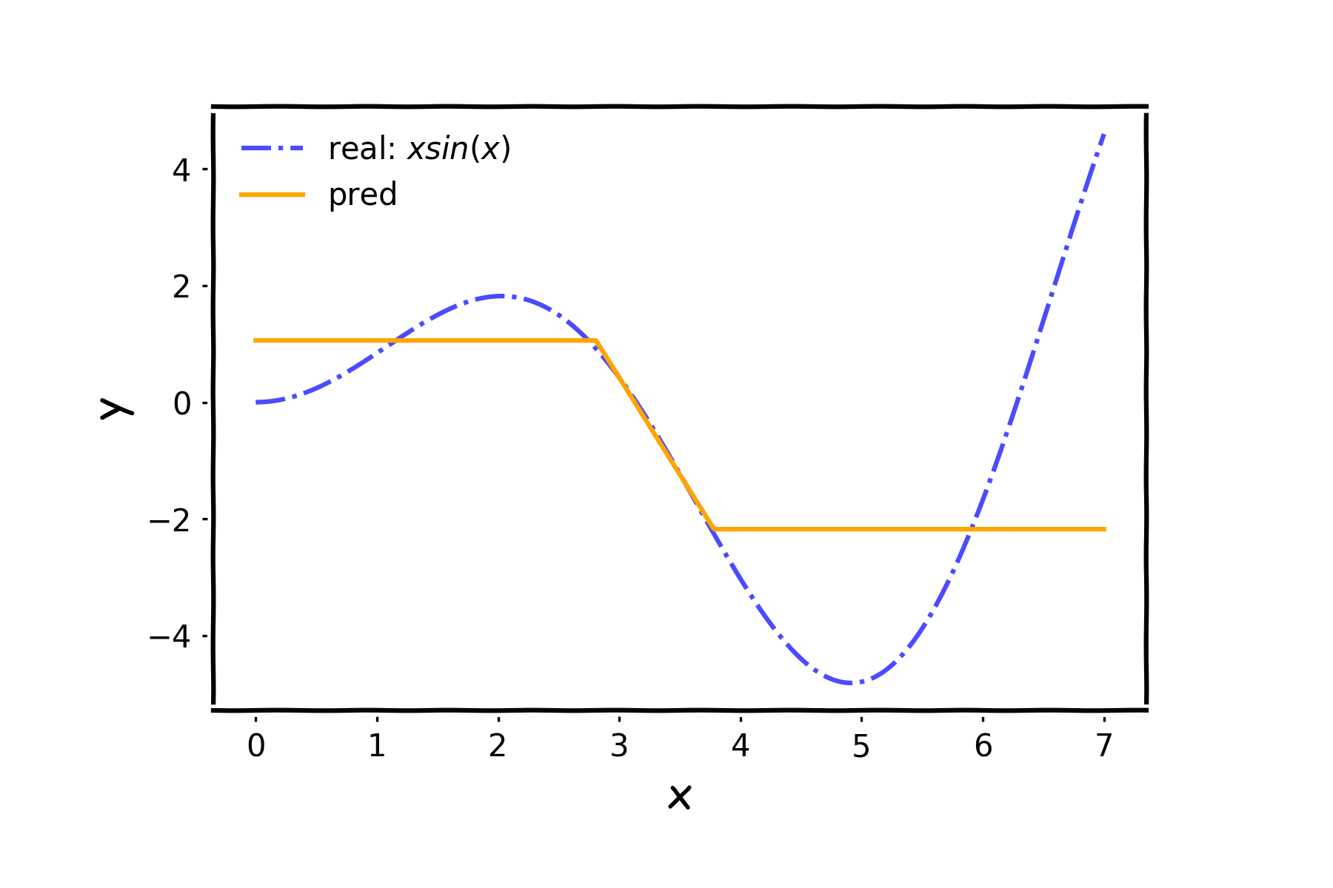
NN in action

Slide 13
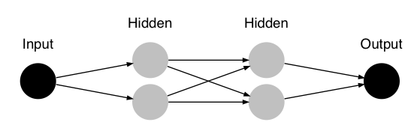
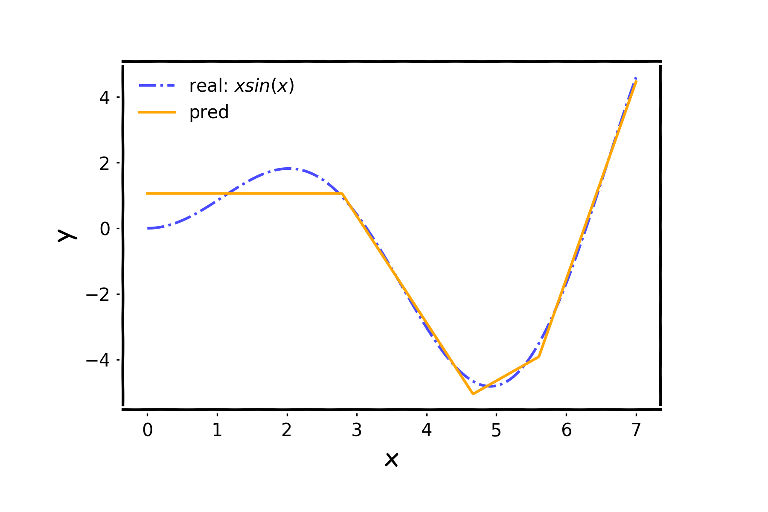
NN in action

Slide 14
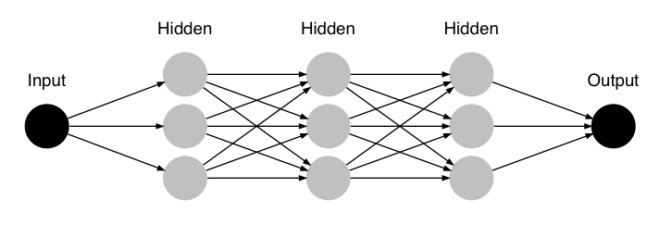
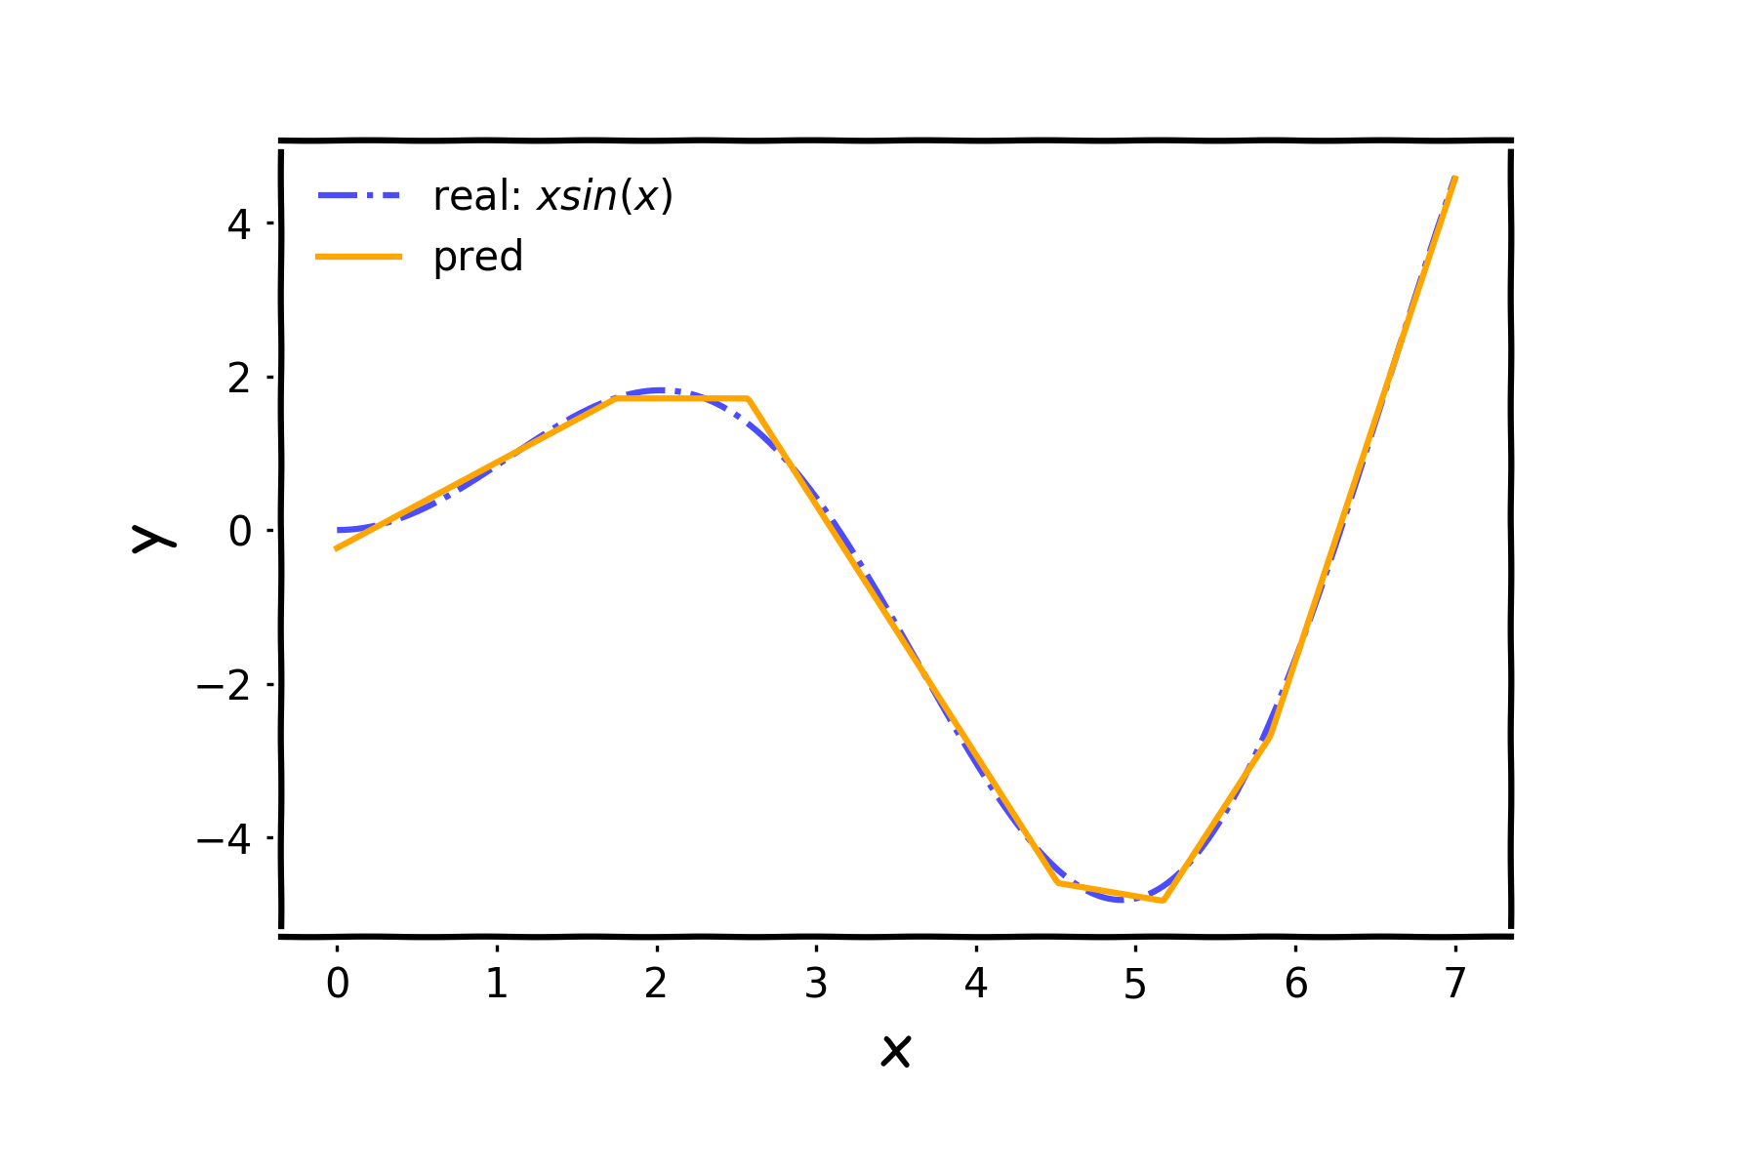
NN in action

Slide 15
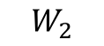
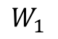
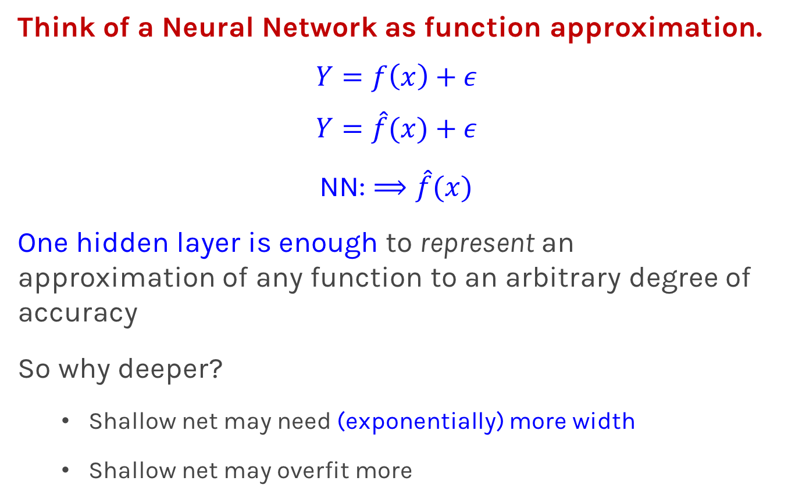
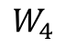
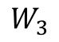
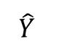
Universal Approximation Theorem
Think of a Neural Network as function approximation.
$$Y=f\left(x\right)+ε$$
$$Y=\hat{f}(x)+ε$$
NN: $⟹\hat{f}(x)$
One hidden layer is enough to represent an approximation of any function to an arbitrary degree of accuracy
So why deeper?
Shallow net may need (exponentially) more width
Shallow net may overfit more
$$W_{3}$$
$$\hat{Y}$$
$$W_{2}$$
$$W_{4}$$
depth
$$W_{1}$$
width

Slide 16
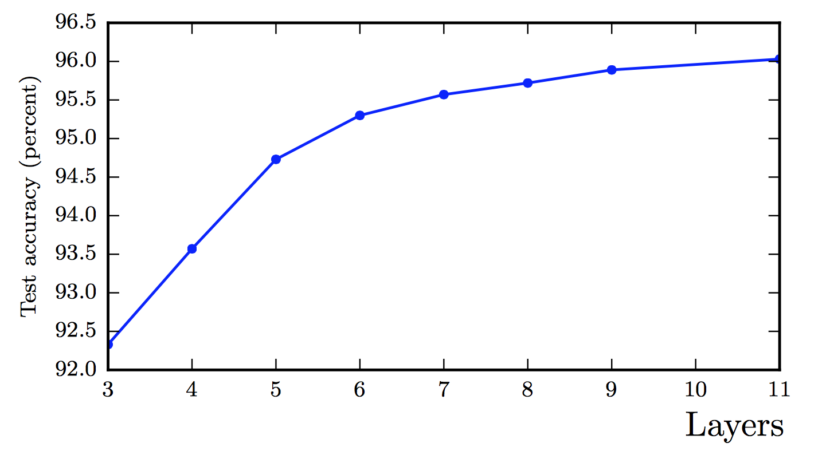
Better Generalization with Depth
(Goodfellow 2017)

Slide 17
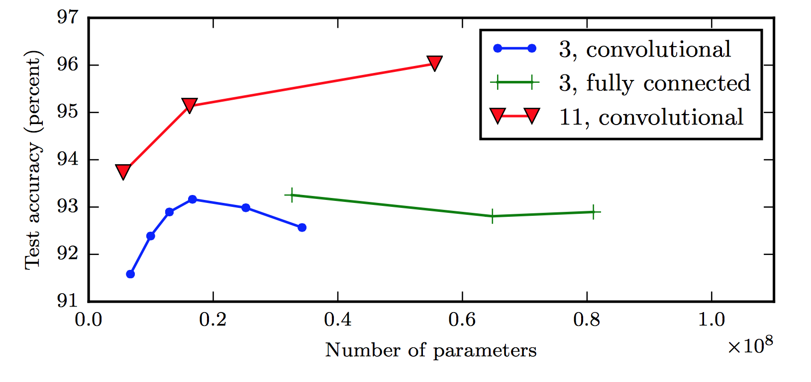
Shallow Nets Overfit More
Depth helps, and it’s not just because of more parameters
Don’t worry about this word “convolutional”. It’s just a special type of neural network, often used for images.
(Goodfellow 2017)
The 11-layer net generalizes better on the test set when controlling for number of parameters.
The 3-layer nets perform worse on the test set, even with similar number of total parameters.

Slide 18
Variable Importance

Slide 19
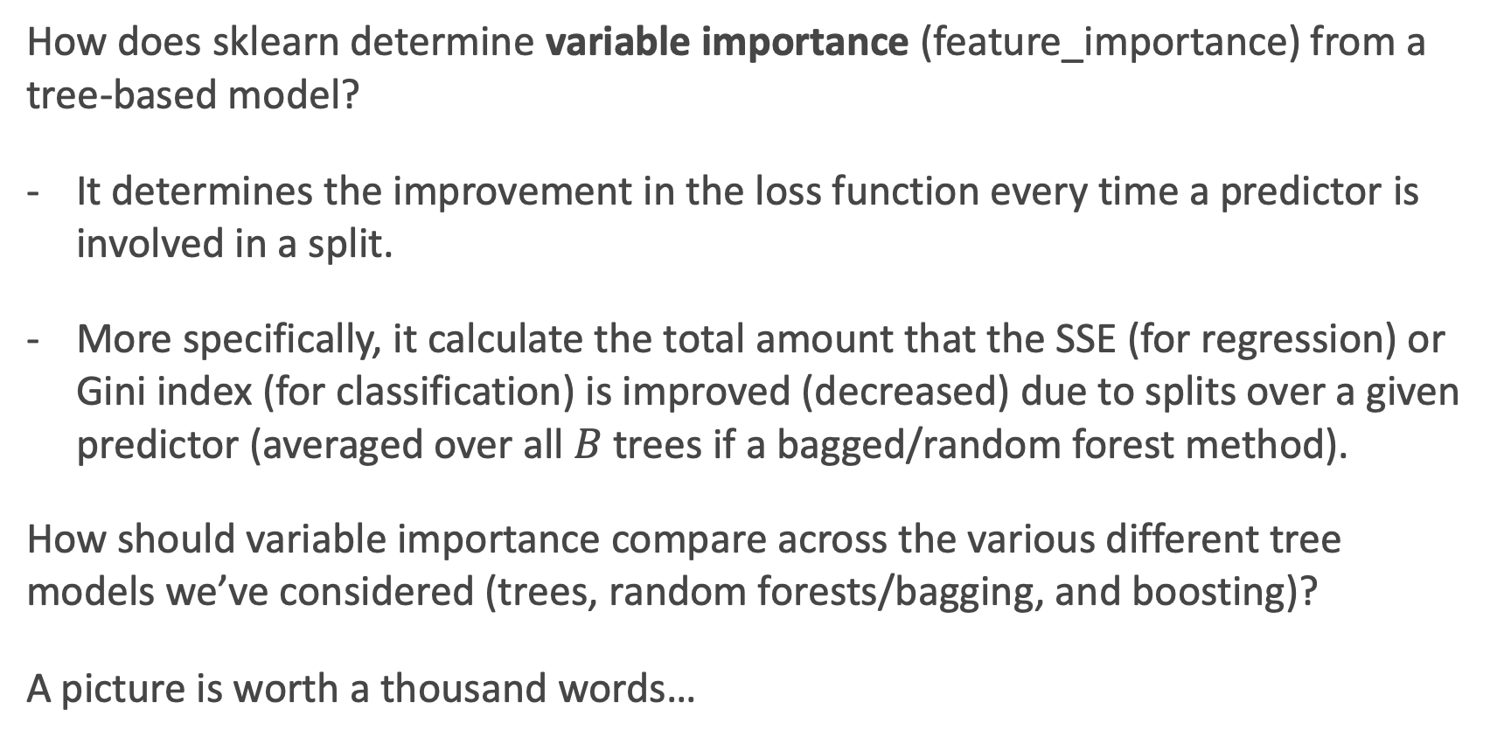
Variable Importance for Tree-Based Models
How does sklearn determine variable importance (feature_importance) from a tree-based model?
It determines the improvement in the loss function every time a predictor is involved in a split.
More specifically, it calculate the total amount that the SSE (for regression) or Gini index (for classification) is improved (decreased) due to splits over a given predictor (averaged over all $B$ trees if a bagged/random forest method).
How should variable importance compare across the various different tree models we’ve considered (trees, random forests/bagging, and boosting)?
A picture is worth a thousand words…

Slide 20
Variable Importance for trees, bags, and boosts
Below are the variable importance plots for the top 10 predictors for each of a (i) decision tree with maxdepth=3, (ii) decision tree with maxdepth=10, (iii) a random forest, and (iv) an adaboost classifier.
Compare them? Are the differences surprising?

Slide 21
Feature Importance in a Neural Network
How can one measure feature importance in a Neural Network?
Its not so easy ☹. What could potentially be done?
We can calculate the predictions from a neural net, and then fit a decision tree model to the predicted values.
What can go wrong with this approach?

Slide 22
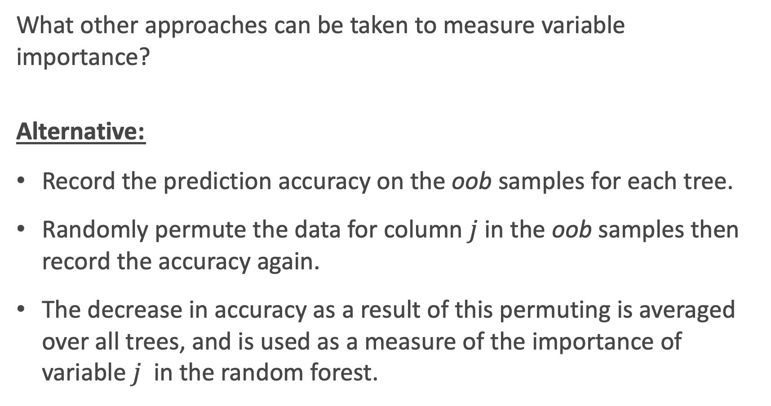
Other Variable Importance Measures
What other approaches can be taken to measure variable importance?
Alternative:
Record the prediction accuracy on the oob samples for each tree.
Randomly permute the data for column $j$in the oob samples then record the accuracy again.
The decrease in accuracy as a result of this permuting is averaged over all trees, and is used as a measure of the importance of variable $j$ in the random forest.

Slide 23
Permutation Variable Importance
This idea of re-permuting a variable and refitting a model to see how much more poorly it performs is called permutation feature importance.
It is sometimes preferred to the standard feature importance, why?
When two features are correlated and one of the features is permuted, the model will still have access to the feature through its correlated feature.
What is the one glaring disadvantage to this?
Computational time, and things may not ‘add up’.

Slide 24
Permutation Variable Importance in sklearn
To perform permutation variable importance in sklearn (or keras), one can use the ELI5 library:
https://eli5.readthedocs.io/en/latest/index.html
This is easy to do with sklearn models, but not easy to do with tensorflow (but it can be done).
An example is worth a thousand words:

Slide 25
Permutation Variable Importance Example

Slide 26
The problem with Variable Importance
Variable Importance is great! It tells you what features are important in shaping the model.
But what is missing?
It does not give any measure for how the predictors are related to the response (positive, negative, quasi-linear, curved, interactions, etc.).
This is where the parametric model wins out! Inference and interpretations are much easier and the whole point in these models.
What can we do to measure these relationships in a machine learning or non-parametric model? Think: what did we do with k-NN?
What needs to be done algorithmically to put this in practice?

Slide 28
Interpretation through Predictions

Slide 29
Parametric vs. Nonparametric models
In a machine learning model (like ensemble methods and neural networks), the association between predictors and the response are not measured directly as these models are ‘black box’ models:
Inputs (X, predictors). → black box (NN, sklearn, etc.) → Outputs (Y, response)
What if we care about how the predictors relate to the response? This is where we need to figure out what the black box is doing to transform the inputs into the outputs.

Slide 30
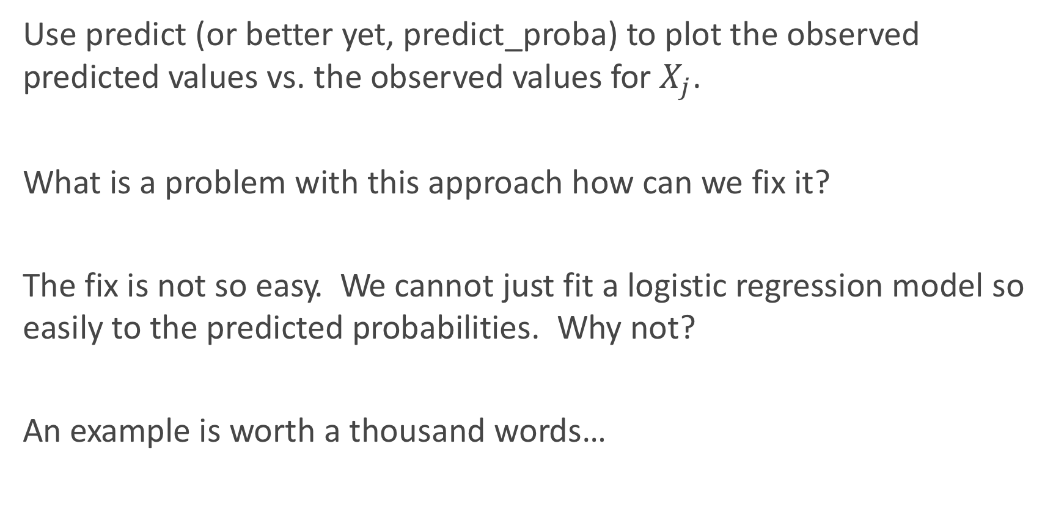
Simplest Approach: observed $\hat{Y}$ vs. $X_{j}$
Use predict (or better yet, predict_proba) to plot the observed predicted values vs. the observed values for $X_{j}$.
What is a problem with this approach how can we fix it?
The fix is not so easy. We cannot just fit a logistic regression model so easily to the predicted probabilities. Why not?
An example is worth a thousand words…

Slide 31
Example: observed $\hat{Y}$ vs. $X_{j}$

Slide 32
Unboxing the black box
Inputs (X, predictors). → black box (NN, sklearn, etc.) → Outputs (Y, response)
This gives us our approach: vary the inputs (the predictors) and see what happens to the response.
If we care about the ‘marginal’ or ‘conditional’ effect of how a specific X relates to Y, then we should vary only one predictor at a time.
How should we handle the other predictors? That is to say, what value should we keep them at?

Slide 33
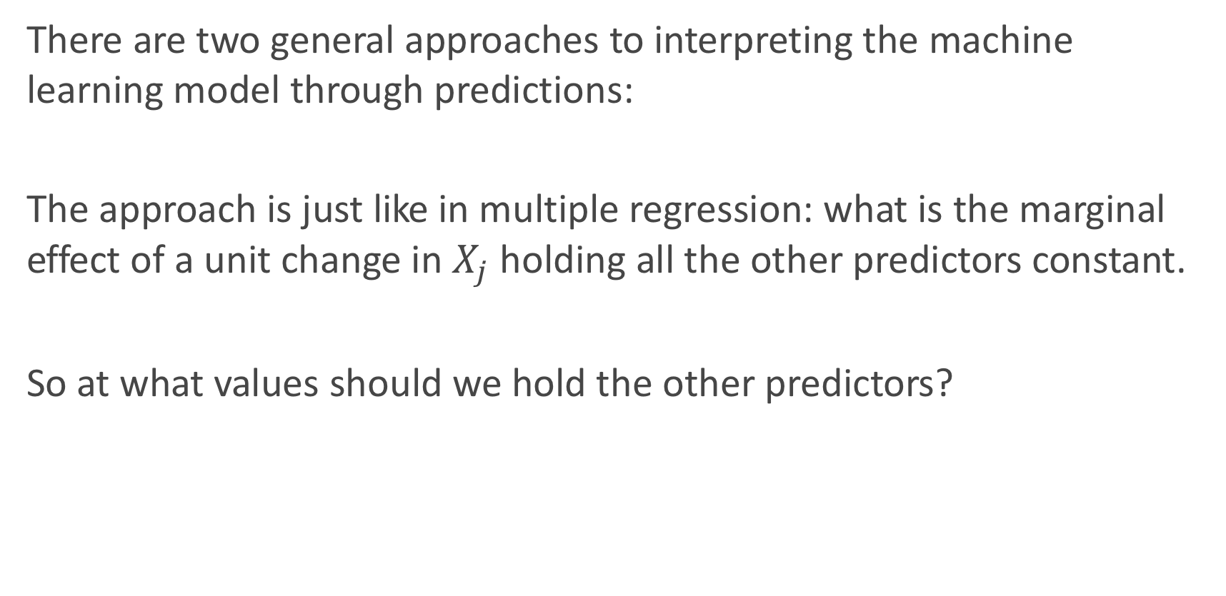
Unboxing the black box (cont.)
There are two general approaches to interpreting the machine learning model through predictions:
The approach is just like in multiple regression: what is the marginal effect of a unit change in $X_{j}$ holding all the other predictors constant.
So at what values should we hold the other predictors?

Slide 34
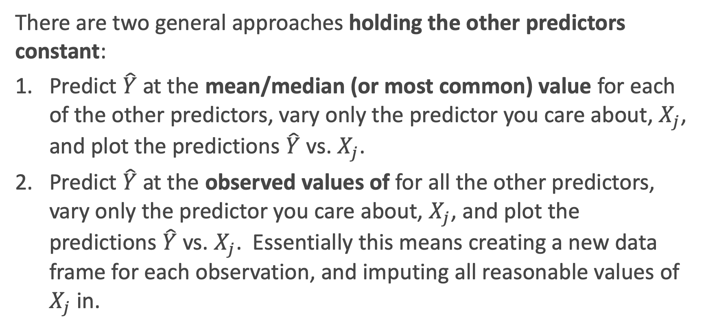
There are two general approaches holding the other predictors constant:
Predict $\hat{Y}$ at the mean/median (or most common) value for each of the other predictors, vary only the predictor you care about, $X_{j}$, and plot the predictions $\hat{Y}$ vs. $X_{j}$.
Predict $\hat{Y}$ at the observed values of for all the other predictors, vary only the predictor you care about, $X_{j}$, and plot the predictions $\hat{Y}$ vs. $X_{j}$. Essentially this means creating a new data frame for each observation, and imputing all reasonable values of $X_{j}$ in.

Slide 35
Predicted probabilities vs. Age at the means
Interpret this plot. What does this say for how Cardiac Arrest is associated with Age?

Slide 36
Predicted probabilities vs. Age for all observations
Interpret this plot. What does this say for how Cardiac Arrest is associated with Age?

Slide 37
What if we want the joint relationship with two predictors?
How can we look at how the response relates to two predictors at once?
This is a bit trickier to do. Why?
We can go back to our friend: the classification boundary!

Slide 38
Should I use PCA components?
What if we want an overall picture of how the response relates to the predictors?
Well, this is where PCA components sometimes come in to play.
But this is no Bueno for interpretability. Why?

Slide 39
Adding Uncertainty

Slide 40
Adding Uncertainty
Not only should we plot predictions, but we can (should) also include the uncertainty of these predictions.
For example, there may be a big difference between the uncertainty of estimated probability curve if n = 100 vs. n = 10,000.
How can we add uncertainty measures to these predictions? How do we do it for linear/logistic regression?
Bootstrapping

Slide 42
Bootstrapping Basics, review
How do we perform a bootstrap? What are the key steps?
The bootstrap algorithm is an approach to mimic the uncertainty of taking the observed sample from a population. So we:
Sample the same number of observations as was observed (in train).
Sample with replacement (so we get some randomness).
Why does this work?

Slide 43
Bootstrapping Basics, review
When is a bootstrapping approach used?
When a probabilistic closed form solution is not known or not easy to get at.
When the assumptions for a parametric model break down.
When there is no ‘formula’ at all to add the uncertainty into a calculation.
Or we are just being lazy.

Slide 44
Bootstrapping Basics, review
How do we use the results of a bootstrap technique?
It provides us a re-created estimate every time we bootstrap.
This estimate could be a mean, a beta, a plot of average predictions, etc.
But they will almost always be for a summary, not a single observation, and thus the sample size is already taken care of (the n in the formula). Aka, do not divide by sqrt(n) again!

Slide 45
Bootstrapping for Predictions
So we can refit a model on a bootstrap sample of data, and look at the predicted probabilities each time.
Then we can take the top 97.5th percentile and bottom 2.5th percentile to build a 95% confidence interval for the predictions!
But how does this work for random forests and bagging models? Yikes!

Slide 46
Back Propagation

Slide 47
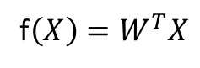
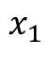
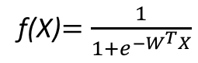
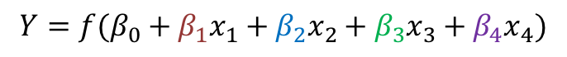
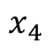
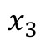
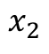
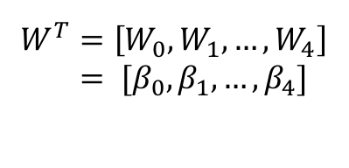
Learning the coefficients
Start with Regression or Logistic Regression
Classification
Regression
f(X)$=\frac{1}{{1+e}^{−W^{T}X}}$
f$\left(X\right)=W^{T}X$
$$W^{T}=\left[W_{0},W_{1},…, W_{4}\right]$$
$= [β_{0}, β_{1},…, β_{4}]$
$$x_{1}$$
$$x_{2}$$
$$Y=f(β_{0}+β_{1}x_{1}+β_{2}x_{2}+β_{3}x_{3}+β_{4}x_{4})$$
$$x_{3}$$
$$x_{4}$$
Intercept or Bias
Coefficients or Weights

Slide 48
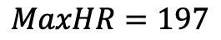
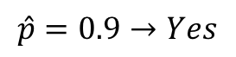
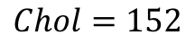
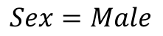
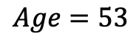
But what is the idea?
Start with all randomly selected weights. Most likely it will perform horribly.
For example, in our heart data, the model will be giving us the wrong answer.
$$MaxHR=197$$
Correct
$$Age=53$$
$$\hat{p}=0.9→Yes$$
y=No
$$Sex=Male$$
$$Chol=152$$
Bad Computer

Slide 49
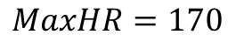
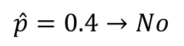
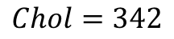
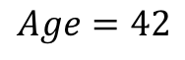
But what is the idea?
Start with all randomly selected weights. Most likely it will perform horribly.
For example, in our heart data, the model will be giving us the wrong answer.
$$MaxHR=170$$
Correct
$$Age=42$$
$$\hat{p}=0.4→No$$
y=Yes
$$Sex=Male$$
$$Chol=342$$
Bad Computer

Slide 50
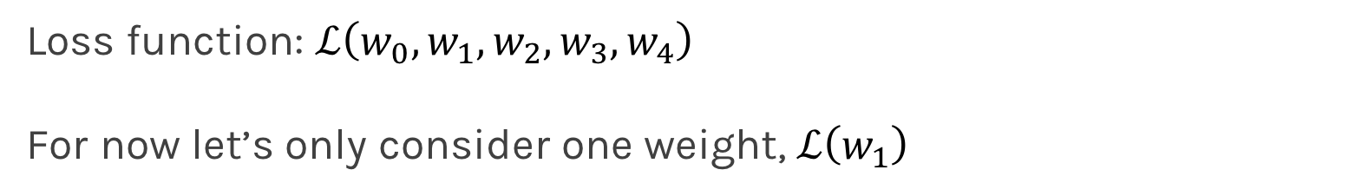
But what is the idea?
Loss Function: Takes all of these results and averages them and tells us how bad or good the computer or those weights are.
Telling the computer how bad or good is, does not really help.
You want to tell it how to change those weights so it gets better.
Loss function: $ℒ\left(w_{0},w_{1},w_{2},w_{3},w_{4}\right)$
For now let’s only consider one weight, $ℒ\left(w_{1}\right)$

Slide 51
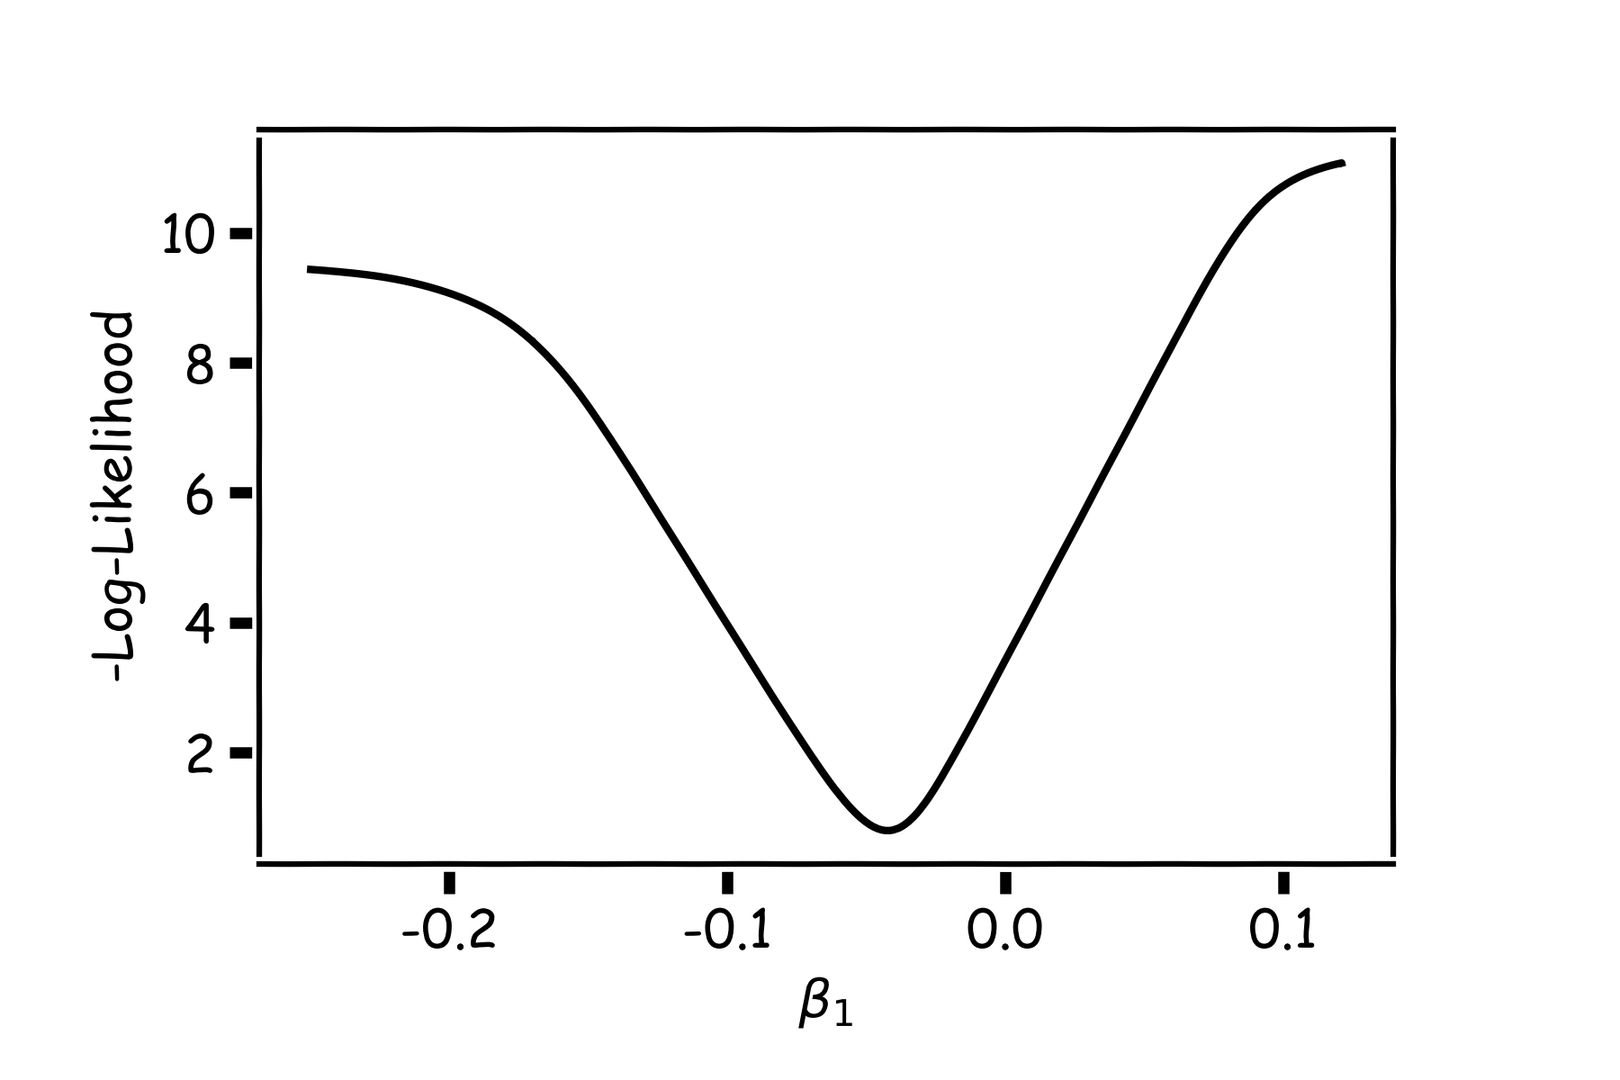
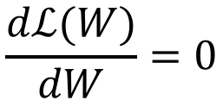

Minimizing the Loss function
Ideally we want to know the value of $w_{1}$ that gives the minimal $ℒ\left(W\right)$
To find the optimal point of a function $ℒ\left(W\right)$
And find the $W$ that satisfies that equation. Sometimes there is no explicit solution for that.
$$\frac{dℒ(W)}{dW}=0$$

Slide 52
Estimate of the regression coefficients: gradient descent
A more flexible method is
Start from a random point
Determine which direction to go to reduce the loss (left or right)
Compute the slope of the function at this point and step to the right if slope is negative or step to the left if slope is positive
Goto to #1

Slide 53
Minimization of the Loss Function
Question: What is the mathematical function that describes the slope?
Derivative
Question: How do we generalize this to more than one predictor?
Take the derivative with respect to each coefficient and do the same sequentially
Question: What do you think is a good approach for telling the model how to change (what is the step size) to become better?

Slide 54



Gradient Descent (cont.)
If the step is proportional to the slope then you avoid overshooting the minimum. How?
$$\frac{dℒ(W)}{dW}$$
$$\frac{dℒ(W)}{dW}$$
$$\frac{dℒ(W)}{dW}$$

Slide 55



Let’s play the game
We know that we want to go in the opposite direction of the derivative and we know we want to be making a step proportional to the derivative.
Making a step means:
Step size is proportional to derivative
$${w^{new}=w}^{old}+step$$
Opposite direction of the derivative means:
$${w^{new}=w}^{old}−λ\frac{dℒ}{dw}$$
Learning Rate
Change to more conventional notation:
$${w^{(i+1)}=w}^{(i)}−λ\frac{dℒ}{dw}$$

Slide 56


Gradient Descent
Algorithm for optimization of first order to finding a minimum of a function.
It is an iterative method.
L is decreasing much faster in the direction of the negative derivative.
The learning rate is controlled by the magnitude of $λ$.
$${w^{(i+1)}=w}^{(i)}−λ\frac{dℒ}{dw}$$
L
-
+
w

Slide 57
Considerations
We still need to calculate the derivatives.
We need to know what is the learning rate or how to set it.
Local vs global minima.
The full likelihood function includes summing up all individual ‘errors’. Unless you are a statistician, sometimes this includes hundreds of thousands of examples.

Slide 58
Considerations
We still need to calculate the derivatives.
We need to know what is the learning rate or how to set it.
Local vs global minima.
The full likelihood function includes summing up all individual ‘errors’. Unless you are a statistician, sometimes this includes hundreds of thousands of examples.

Slide 59
Calculate the Derivatives
Can we do it?
Wolfram Alpha can do it for us!
We need a formalism to deal with these derivatives.
Example: Logistic Regression derivatives

Slide 60



Chain Rule
Chain rule for computing gradients:
$y=g\left(x\right) z=f\left(y\right)=f\left(g\left(x\right)\right)$
For longer chains:
$$y=g\left(x \right) z=f\left(y\right)=f\left(g\left(x \right)\right)$$
$$\frac{∂z}{∂x_{i}}=\sum_{j}{\frac{∂z}{∂y_{j}}\frac{∂y_{j}}{∂x_{i}}}$$
$$\frac{∂z}{∂x}=\frac{∂z}{∂y}\frac{∂y}{∂x}$$

Slide 61




Logistic Regression derivatives
For logistic regression, the negative log of the likelihood is:
$$ℒ=\sum_{i}{ℒ_{i}}=−\sum_{i}{\log{L_{i}}}{=−\sum_{i}{[y_{i}\log{p_{i}+\left(1−y_{i}\right)\log{(1−p_{i})]}}}}$$
$$ℒ_{i}={−y}_{i}\log{\frac{1}{1+e^{−W^{T}X}}−\left(1−y_{i}\right)\log{(1−\frac{1}{1+e^{−W^{T}X}})}}$$
To simplify the analysis let us split it into two parts,
$$ℒ_{i}=ℒ_{i}^{A}+ℒ_{i}^{B}$$
So the derivative with respect to W is:
$\frac{∂ℒ}{∂W}=\sum_{i}{\frac{∂ℒ_{i}}{∂W}}=\sum_{i}{(}\frac{∂ℒ_{i}^{A}}{∂W}$+ $\frac{∂ℒ_{i}^{B}}{∂W}$)

Slide 62


$$ℒ_{i}^{A}={−y}_{i}\log{\frac{1}{1+e^{−W^{T}X}}}$$
Variables | Partial derivatives | Partial derivatives
$$ξ_{1}=−W^{T}X$$ | $$\frac{∂ξ_{1}}{∂W}=−X$$ | $$\frac{∂ξ_{1}}{∂W}=−X$$
$$ξ_{2}={e^{ξ_{1}}=e}^{−W^{T}X}$$ | $$\frac{∂ξ_{2}}{∂ξ_{1}}=e^{ξ_{1}}$$ | $$\frac{∂ξ_{2}}{∂ξ_{1}}=e^{−W^{T}X}$$
$$ξ_{3}=1+ξ_{2}=1+e^{−W^{T}X}$$ | $$\frac{∂ξ_{3}}{∂ξ_{2}}=1$$ | $\frac{∂ξ_{3}}{∂ξ_{2}}=$1
$$ξ_{4}=\frac{1}{ξ_{3}}=\frac{1}{1+e^{−W^{T}X}}=p$$ | $$\frac{∂ξ_{4}}{∂ξ_{3}}=−\frac{1}{ξ_{3}^{2}}$$ | $$\frac{∂ξ_{4}}{∂ξ_{3}}=−\frac{1}{{\left(1+e^{−W^{T}X}\right)}^{2}}$$
$$ξ_{5}=\log{ξ_{4}=\log{p =}\log{\frac{1}{1+e^{−W^{T}X}}}}$$ | $$\frac{∂ξ_{5}}{∂ξ_{4}}=\frac{1}{ξ_{4}}$$ | $$\frac{∂ξ_{5}}{∂ξ_{4}}=1+e^{−W^{T}X}$$
$$ℒ_{i}^{A}=−yξ_{5}$$ | $$\frac{∂ℒ}{∂ξ_{5}}=−y$$ | $$\frac{∂ℒ}{∂ξ_{5}}=−y$$
$$\frac{∂ℒ_{i}^{A}}{∂W}=\frac{∂ℒ_{i}}{∂ξ_{5}}\frac{∂ξ_{5}}{∂ξ_{4}}\frac{∂ξ_{4}}{∂ξ_{3}}\frac{∂ξ_{3}}{∂ξ_{2}}\frac{∂ξ_{2}}{∂ξ_{1}}\frac{∂ξ_{1}}{∂W}$$ |  | $${\frac{∂ℒ_{i}^{A}}{∂W}=−yXe}^{−W^{T}X}\frac{1}{{\left(1+e^{−W^{T}X}\right)}^{}}$$

Slide 63


$$ℒ_{i}^{B}={−(1−y}_{i})\log{[1−\frac{1}{1+e^{−W^{T}X}}]}$$
Variables | derivatives | Partial derivatives wrt to X,W
$$ξ_{1}=−W^{T}X$$ | $$\frac{∂ξ_{1}}{∂W}=−X$$ | $$\frac{∂ξ_{1}}{∂W}=−X$$
$$ξ_{2}={e^{ξ_{1}}=e}^{−W^{T}X}$$ | $$\frac{∂ξ_{2}}{∂ξ_{1}}=e^{ξ_{1}}$$ | $$\frac{∂ξ_{2}}{∂ξ_{1}}=e^{−W^{T}X}$$
$$ξ_{3}=1+ξ_{2}=1+e^{−W^{T}X}$$ | $$\frac{∂ξ_{3}}{∂ξ_{2}}=1$$ | $\frac{∂ξ_{3}}{∂2}=$1
$$ξ_{4}=\frac{1}{ξ_{3}}=\frac{1}{1+e^{−W^{T}X}}=p$$ | $$\frac{∂ξ_{4}}{∂ξ_{3}}=−\frac{1}{ξ_{3}^{2}}$$ | $$\frac{∂ξ_{4}}{∂ξ_{3}}=−\frac{1}{{\left(1+e^{−W^{T}X}\right)}^{2}}$$
$$ξ_{5}=1−ξ_{4}=1−\frac{1}{1+e^{−W^{T}X}}$$ | $$\frac{∂ξ_{5}}{∂ξ_{4}}=−1$$ | $\frac{∂ξ_{5}}{∂ξ_{4}}=$-1
$$ξ_{6}=\log{ξ_{5}=\log{(1−p) =}\log{\frac{1}{1+e^{−W^{T}X}}}}$$ | $$\frac{∂ξ_{6}}{∂ξ_{5}}=\frac{1}{ξ_{5}}$$ | $$\frac{∂ξ_{6}}{∂ξ_{5}}=\frac{1+e^{−W^{T}X} }{e^{−W^{T}X}}$$
$$ℒ_{i}^{B}=(1−y)ξ_{6}$$ | $$\frac{∂ℒ}{∂ξ_{6}}=1−y$$ | $$\frac{∂ℒ}{∂ξ_{6}}=1−y$$
$$\frac{∂ℒ_{i}^{B}}{∂W}=\frac{∂ℒ_{i}^{B}}{∂ξ_{6}}\frac{∂ξ_{6}}{∂ξ_{5}}\frac{∂ξ_{5}}{∂ξ_{4}}\frac{∂ξ_{4}}{∂ξ_{3}}\frac{∂ξ_{3}}{∂ξ_{2}}\frac{∂ξ_{2}}{∂ξ_{1}}\frac{∂ξ_{1}}{∂W}$$ |  | $$\frac{∂ℒ_{i}^{B}}{∂W}=(1−y)X\frac{1}{{\left(1+e^{−W^{T}X}\right)}^{}}$$

Slide 64
Considerations
We still need to calculate the derivatives.
We need to know what is the learning rate or how to set it.
Local vs global minima.
The full likelihood function includes summing up all individual ‘errors’. Unless you are a statistician, sometimes this includes hundreds of thousands of examples.

Slide 65

Learning Rate
Trial and Error.
There are many alternative methods which address how to set or adjust the learning rate, using the derivative or second derivatives and or the momentum. Presented in optional notes at the end of these slides.
J. Nocedal y S. Wright, “Numerical optimization”, Springer, 1999 🔗
TLDR: J. Bullinaria, “Learning with Momentum, Conjugate Gradient Learning”, 2015 🔗

Slide 66
Considerations
We still need to calculate the derivatives.
We need to know what is the learning rate or how to set it.
Local vs global minima.
The full likelihood function includes summing up all individual ‘errors’. Unless you are a statistician, sometimes this includes hundreds of thousands of examples.

Slide 67
Local vs Global Minima
L
𝛉

Slide 68
Local vs Global Minima
L
𝛉

Slide 69
Local vs Global Minima
No guarantee that we get the global minimum.
Question: What would be a good strategy?

Slide 70
Considerations
We still need to calculate the derivatives.
We need to know what is the learning rate or how to set it.
Local vs global minima.
The full likelihood function includes summing up all individual ‘errors’. Unless you are a statistician, sometimes this includes hundreds of thousands of examples.

Slide 71


Batch and Stochastic Gradient Descent
$$ℒ=−\sum_{i}{[y_{i}\log{p_{i}+\left(1−y_{i}\right)\log{(1−p_{i})]}}}$$
Instead of using all the observations for every step, use a subset of them (batch).
For each iteration k, use the following loss function to derive the derivatives:
which is an approximation to the full loss function.
$$ℒ^{k}=−\sum_{i∈b^{k}}{[y_{i}\log{p_{i}+\left(1−y_{i}\right)\log{(1−p_{i})]}}}$$

Slide 72
Batch and Stochastic Gradient Descent
Full Likelihood:
L
Batch Likelihood:
𝛉

Slide 73
Batch and Stochastic Gradient Descent
Full Likelihood:
L
Batch Likelihood:
𝛉

Slide 74
Batch and Stochastic Gradient Descent
Full Likelihood:
L
Batch Likelihood:
𝛉

Slide 75
Batch and Stochastic Gradient Descent
Full Likelihood:
L
Batch Likelihood:
𝛉

Slide 76
Batch and Stochastic Gradient Descent
Full Likelihood:
L
Batch Likelihood:
𝛉

Slide 77
Batch and Stochastic Gradient Descent
Full Likelihood:
L
Batch Likelihood:
𝛉

Slide 78
Batch and Stochastic Gradient Descent
Full Likelihood:
L
Batch Likelihood:
𝛉

Slide 79
Batch and Stochastic Gradient Descent
Full Likelihood:
L
Batch Likelihood:
𝛉

Slide 80
Batch and Stochastic Gradient Descent
Full Likelihood:
L
Batch Likelihood:
𝛉

Slide 81
Backpropagation

Slide 82











Backpropagation: Logistic Regression Revisited
Affine
Activation
Loss Fun
$$ℒ(β)=\sum_{i}^{n}{ℒ_{i}\left(β\right)}$$
$$p=\frac{1}{1+e^{−h}}$$
$$X$$
$$h=β_{0}+β_{1}X$$
$\frac{∂ℒ}{∂p}$ $\frac{∂p}{∂h}$ $\frac{∂h}{∂β}$
$\frac{∂ℒ}{∂p}$ $\frac{∂p}{∂h}$
$$\frac{∂ℒ}{∂p}$$
$$\frac{∂h}{∂β_{1}}=X,\frac{dℒ}{dβ_{0}}=1$$
$$\frac{∂p}{∂h}=σ(h)(1−σ\left(h\right))$$
$$\frac{∂ℒ}{∂p}=−y\frac{1}{p}−\left(1−y\right)\frac{1}{1−p}$$
$$\frac{∂ℒ}{∂β_{1}}=−Xσ\left(h\right)\left(1−σ\left(h\right)\right)[y\frac{1}{p}+\left(1−y\right)\frac{1}{1−p}]$$
$$\frac{∂ℒ}{∂β_{0 }}=−σ\left(h\right)\left(1−σ\left(h\right)\right)[ y\frac{1}{p}+\left(1−y\right)\frac{1}{1−p}]$$

Slide 83



Backpropagation
Derivatives need to be evaluated at some values of X, y and W.
But since we have an expression, we can build a function that takes as input X, y, W and returns the derivatives and then we can use gradient descent to update.
This approach works well but it does not generalize. For example if the network is changed, we need to write a new function to evaluate the derivatives.
For example this network will need a different function for the derivatives
W₁
$$W_{3}$$
$$X$$
$$Y$$
W₂

Slide 84





Backpropagation
Derivatives need to be evaluated at some values of X, y and W.
But since we have an expression, we can build a function that takes as input X, y, W and returns the derivatives and then we can use gradient descent to update.
This approach works well but it does not generalize. For example if the network is changed, we need to write a new function to evaluate the derivatives.
For example this network will need a different function for the derivatives
W₁
$$W_{3}$$
$$W_{5}$$
$$X$$
$$Y$$
W₂
$$W_{4}$$

Slide 85

Backpropagation: a new game
Need to find a formalism to calculate the derivatives of the loss w.r.t. weights that is:
Flexible enough that adding a node or a layer or changing something in the network won’t require to re-derive the functional form from scratch.
It is exact.
It is computationally efficient.
Hints:
Remember we only need to evaluate the derivatives at $X_{i}, y_{i}$ and $W^{(k)}.$
We should take advantage of the chain rule we learned before

Slide 86
Idea 1: Evaluate the derivative at: X={3}, y=1, W=3
Variables | derivatives | Value of the variable | Value of the partial derivative | $$\frac{dξ_{n}}{dW}$$
$$ξ_{1}=−W^{T}X$$ | $$\frac{∂ξ_{1}}{∂W}=−X$$ | $$−9$$ | -3 | -3
$$ξ_{2}={e^{ξ_{1}}=e}^{−W^{T}X}$$ | $$\frac{∂ξ_{2}}{∂ξ_{1}}=e^{ξ_{1}}$$ | $$e^{−9}$$ | $$e^{−9}$$ | -3$e^{−9}$
$$ξ_{3}=1+ξ_{2}=1+e^{−W^{T}X}$$ | $$\frac{∂ξ_{3}}{∂ξ_{2}}=1$$ | 1+$e^{−9}$ | 1 | -3$e^{−9}$
$$ξ_{4}=\frac{1}{ξ_{3}}=\frac{1}{1+e^{−W^{T}X}}=p$$ | $$\frac{∂ξ_{4}}{∂ξ_{3}}=−\frac{1}{ξ_{3}^{2}}$$ | $$\frac{1}{1+e^{−9}}$$ | $${\left(\frac{1}{1+e^{−9}}\right)}^{2}$$ | -3$e^{−9}{\left(\frac{1}{1+e^{−9}}\right)}^{2}$
$$ξ_{5}=\log{ξ_{4}=\log{p =}\log{\frac{1}{1+e^{−W^{T}X}}}}$$ | $$\frac{∂ξ_{5}}{∂ξ_{4}}=\frac{1}{ξ_{4}}$$ | $$\log{\frac{1}{1+e^{−9}}}$$ | $$1+e^{−9}$$ | -3$e^{−9}{\left(\frac{1}{1+e^{−9}}\right)}^{}$
$$ℒ_{i}^{A}=−yξ_{5}$$ | $$\frac{∂ℒ}{∂ξ_{5}}=−y$$ | $$−\log{\frac{1}{1+e^{−9}}}$$ | $$−1$$ | 3$e^{−9}{\left(\frac{1}{1+e^{−9}}\right)}^{}$
$$\frac{∂ℒ_{i}^{A}}{∂W}=\frac{∂ℒ_{i}}{∂ξ_{5}}\frac{∂ξ_{5}}{∂ξ_{4}}\frac{∂ξ_{4}}{∂ξ_{3}}\frac{∂ξ_{3}}{∂ξ_{2}}\frac{∂ξ_{2}}{∂ξ_{1}}\frac{∂ξ_{1}}{∂W}$$ |  |  | $$−3$$ | 0.00037018372

Slide 87

Basic functions
We still need to derive derivatives ☹
Variables | derivatives | Value of the variable | Value of the partial derivative | $$\frac{dξ_{n}}{dW}$$
$$ξ_{1}=−W^{T}X$$ | $$\frac{∂ξ_{1}}{∂W}=−X$$ | $$−9$$ | -3 | -3
$$ξ_{2}={e^{ξ_{1}}=e}^{−W^{T}X}$$ | $$\frac{∂ξ_{2}}{d∂ξ_{1}}=e^{ξ_{1}}$$ | $$e^{−9}$$ | $$e^{−9}$$ | -3$e^{−9}$
$$ξ_{3}=1+ξ_{2}=1+e^{−W^{T}X}$$ | $$\frac{∂ξ_{3}}{∂ξ_{2}}=1$$ | 1+$e^{−9}$ | 1 | -3$e^{−9}$
$$ξ_{4}=\frac{1}{ξ_{3}}=\frac{1}{1+e^{−W^{T}X}}=p$$ | $$\frac{∂ξ_{4}}{∂ξ_{3}}=−\frac{1}{ξ_{3}^{2}}$$ | $$\frac{1}{1+e^{−9}}$$ | $${\left(\frac{1}{1+e^{−9}}\right)}^{2}$$ | -3$e^{−9}{\left(\frac{1}{1+e^{−9}}\right)}^{2}$
$$ξ_{5}=\log{ξ_{4}=\log{p =}\log{\frac{1}{1+e^{−W^{T}X}}}}$$ | $$\frac{∂ξ_{5}}{∂ξ_{4}}=\frac{1}{ξ_{4}}$$ | $$\log{\frac{1}{1+e^{−9}}}$$ | $$1+e^{−9}$$ | -3$e^{−9}{\left(\frac{1}{1+e^{−9}}\right)}^{}$
$$ℒ_{i}^{A}=−yξ_{5}$$ | $$\frac{∂ℒ}{∂ξ_{5}}=−y$$ | $$−\log{\frac{1}{1+e^{−9}}}$$ | $$−1$$ | 3$e^{−9}{\left(\frac{1}{1+e^{−9}}\right)}^{}$
$$\frac{∂ℒ_{i}^{A}}{∂W}=\frac{∂ℒ_{i}}{∂ξ_{5}}\frac{∂ξ_{5}}{∂ξ_{4}}\frac{∂ξ_{4}}{∂ξ_{3}}\frac{∂ξ_{3}}{∂ξ_{2}}\frac{∂ξ_{2}}{∂ξ_{1}}\frac{∂ξ_{1}}{∂W}$$ |  |  | $$−3$$ | 0.00037018372

Slide 88

Basic functions
Notice though those are basic functions that my grandparent can do
$$ξ_{0}=X$$ | $$\frac{∂ξ_{0}}{∂X}=1$$ | def x0(x): return X | def derx0(): return 1
$$ξ_{1}=−W^{T}ξ_{0}$$ | $$\frac{∂ξ_{1}}{∂W}=−X$$ | def x1(a,x): return –a*X | def derx1(a,x): return -a
$$ξ_{2}=e^{ξ_{1}}$$ | $$\frac{∂ξ_{2}}{∂ξ_{1}}=e^{ξ_{1}}$$ | def x2(x): return np.exp(x) | def derx2(x): return np.exp(x)
$$ξ_{3}=1+ξ_{2}$$ | $$\frac{∂ξ_{3}}{∂ξ_{2}}=1$$ | def x3(x): return 1+x | def derx3(x): return 1
$$ξ_{4}=\frac{1}{ξ_{3}}$$ | $$\frac{∂ξ_{4}}{∂ξ_{3}}=−\frac{1}{ξ_{3}^{2}}$$ | def der1(x): return 1/(x) | def derx4(x): return -(1/x)**(2)
$$ξ_{5}=\log{ξ_{4}}$$ | $$\frac{∂ξ_{5}}{∂ξ_{4}}=\frac{1}{ξ_{4}}$$ | def der1(x): return np.log(x) | def derx5(x) return 1/x
$$ℒ_{i}^{A}=−yξ_{5}$$ | $$\frac{∂ℒ}{∂ξ_{5}}=−y$$ | def der1(y,x): return –y*x | def derL(y): return -y

Slide 89


Putting it altogether
1. We specify the network structure
W₁
$$W_{3}$$
$$X$$
$$W_{5}$$
$$Y$$
W₂
$$W_{4}$$
2. Following the computational graph …
What is computational graph?

Slide 90


















$$ξ_{5}=log{\frac{1}{1+e^{−W^{T}X}}}$$
Computational Graph
$$ξ_{4}=\frac{1}{1+e^{−W^{T}X}}$$
$$÷$$
Log
$$ξ_{7}=log(1−{\frac{1}{1+e^{−W^{T}X}})}$$
$$ξ_{3}={1+e}^{−W^{T}X}$$
$$+$$
log
-
1
$$exp$$
$$ξ_{6}=1−{\frac{1}{1+e^{−W^{T}X}}}$$
1-y
$$ξ_{2}=e^{−ξ_{1}} \\ ξ_{2}^{′}={−e}^{−ξ_{1}}$$
$$−$$
$$×$$
$$ξ_{1}=W^{T}X$$ $ξ_{1}^{′}$=X
y
$$×$$
$$×$$
$$ξ_{8}=\left(1−y\right)log(1−{\frac{1}{1+e^{−W^{T}X}})}$$
$$ξ_{9}=ylog({\frac{1}{1+e^{−W^{T}X}})}$$
W
X
$$+$$
$$ξ_{0}=W$$
$$−ℒ=ξ_{9}=ylog({\frac{1}{1+e^{−W^{T}X}})}+ \left(1−y\right)log(1−{\frac{1}{1+e^{−W^{T}X}})}$$

Slide 91
Putting it altogether
1. We specify the network structure
W₁
$$W_{3}$$
$$X$$
$$W_{5}$$
$$Y$$
W₂
$$W_{4}$$
Envision the computational graph (only needed for the reverse mode).
At each node of the graph we build two functions: the evaluation of the variable and its partial derivative with respect to the previous variable (as shown in the table 3 slides back)
Now we can either go forward or backward depending on the situation. In general, forward is easier to implement and to understand. The difference is clearer when there are multiple nodes per layer.

Slide 92

Forward mode: Evaluate the derivative at: X={3}, y=1, W=3
Variables | derivatives | Value of the variable | Value of the partial derivative | $$\frac{dℒ}{dξ_{n}}$$
$$ξ_{1}=−W^{T}X$$ | $$\frac{∂ξ_{1}}{∂W}=−X$$ | $$−9$$ | -3 | -3
$$ξ_{2}={e^{ξ_{1}}=e}^{−W^{T}X}$$ | $$\frac{∂ξ_{2}}{∂ξ_{1}}=e^{ξ_{1}}$$ | $$e^{−9}$$ | $$e^{−9}$$ | -3$e^{−9}$
$$ξ_{3}=1+ξ_{2}=1+e^{−W^{T}X}$$ | $$\frac{∂ξ_{3}}{∂ξ_{2}}=1$$ | 1+$e^{−9}$ | 1 | -3$e^{−9}$
$$ξ_{4}=\frac{1}{ξ_{3}}=\frac{1}{1+e^{−W^{T}X}}=p$$ | $$\frac{∂ξ_{4}}{∂ξ_{3}}=−\frac{1}{ξ_{3}^{2}}$$ | $$\frac{1}{1+e^{−9}}$$ | $${\left(\frac{1}{1+e^{−9}}\right)}^{2}$$ | -3$e^{−9}{\left(\frac{1}{1+e^{−9}}\right)}^{2}$
$$ξ_{5}=\log{ξ_{4}=\log{p =}\log{\frac{1}{1+e^{−W^{T}X}}}}$$ | $$\frac{∂ξ_{5}}{∂ξ_{4}}=\frac{1}{ξ_{4}}$$ | $$\log{\frac{1}{1+e^{−9}}}$$ | $$1+e^{−9}$$ | -3$e^{−9}{\left(\frac{1}{1+e^{−9}}\right)}^{}$
$$ℒ_{i}^{A}=−yξ_{5}$$ | $$\frac{∂ℒ}{∂ξ_{5}}=−y$$ | $$−\log{\frac{1}{1+e^{−9}}}$$ | $$−1$$ | 3$e^{−9}{\left(\frac{1}{1+e^{−9}}\right)}^{}$
$$\frac{∂ℒ_{i}^{A}}{∂W}=\frac{∂ℒ_{i}}{∂ξ_{5}}\frac{∂ξ_{5}}{∂ξ_{4}}\frac{∂ξ_{4}}{∂ξ_{3}}\frac{∂ξ_{3}}{∂ξ_{2}}\frac{∂ξ_{2}}{∂ξ_{1}}\frac{∂ξ_{1}}{∂W}$$ |  |  | $$−3$$ | 0.00037018372

Slide 93

Backward mode: Evaluate the derivative at: X={3}, y=1, W=3
Variables | derivatives | Value of the variable | Value of the partial derivative
$$ξ_{1}=−W^{T}X$$ | $$\frac{∂ξ_{1}}{∂W}=−X$$ | $$−9$$ | -3
$$ξ_{2}={e^{ξ_{1}}=e}^{−W^{T}X}$$ | $$\frac{∂ξ_{2}}{∂ξ_{1}}=e^{ξ_{1}}$$ | $$e^{−9}$$ | $$e^{−9}$$
$$ξ_{3}=1+ξ_{2}=1+e^{−W^{T}X}$$ | $$\frac{∂ξ_{3}}{∂ξ_{2}}=1$$ | 1+$e^{−9}$ | 1
$$ξ_{4}=\frac{1}{ξ_{3}}=\frac{1}{1+e^{−W^{T}X}}=p$$ | $$\frac{∂ξ_{4}}{∂ξ_{3}}=−\frac{1}{ξ_{3}^{2}}$$ | $$\frac{1}{1+e^{−9}}$$ | $${\left(\frac{1}{1+e^{−9}}\right)}^{2}$$
$$ξ_{5}=\log{ξ_{4}=\log{p =}\log{\frac{1}{1+e^{−W^{T}X}}}}$$ | $$\frac{∂ξ_{5}}{∂ξ_{4}}=\frac{1}{ξ_{4}}$$ | $$\log{\frac{1}{1+e^{−9}}}$$ | $$1+e^{−9}$$
$$ℒ_{i}^{A}=−yξ_{5}$$ | $$\frac{∂ℒ}{∂ξ_{5}}=−y$$ | $$−\log{\frac{1}{1+e^{−9}}}$$ | $$−1$$
$$\frac{∂ℒ_{i}^{A}}{∂W}=\frac{∂ℒ_{i}}{∂ξ_{5}}\frac{∂ξ_{5}}{∂ξ_{4}}\frac{∂ξ_{4}}{∂ξ_{3}}\frac{∂ξ_{3}}{∂ξ_{2}}\frac{∂ξ_{2}}{∂ξ_{1}}\frac{∂ξ_{1}}{∂W}$$
Store all these values

Slide 94
Additional Material Outline
Optimization
Challenges in Optimization
Momentum
Adaptive Learning Rate
Parameter Initialization
Batch Normalization
Regularization of NNs
Norm Penalties
Early Stopping
Data Augmentation
Sparse Representation
Dropout

Slide 95

Learning vs. Optimization
Goal of learning: minimize generalization error, or the loss function
$$𝓛\left(W\right)=𝔼_{\left(x,y\right)\sim p_{data}}\left[L(f\left(x,W\right), y\right]$$
In practice, empirical risk minimization:
$$ℒ\left(W\right)=\sum_{i}{\left[L(f\left(x_{i};W\right), y_{i}\right]}$$
f is the neural network
Quantity optimized different from the quantity we care about

Slide 96

Local Minima
Goodfellow et al. (2016)

Slide 97

Critical Points
Points with zero gradient
2nd-derivate (Hessian) determines curvature
Goodfellow et al. (2016)

Slide 98
Local Minima
Old view: local minima is major problem in neural network training
Recent view:
For sufficiently large neural networks, most local minima incur low cost
Not important to find true global minimum

Slide 99


Saddle Points
Both local min and max
Recent studies indicate that in high dim, saddle points are more likely than local min
Gradient can be very small near saddle points
Goodfellow et al. (2016)

Slide 100

Poor Conditioning
Poorly conditioned Hessian matrix
High curvature: small steps leads to huge increase
Learning is slow despite strong gradients
Oscillations slow down progress

Slide 101

No Critical Points
Some cost functions do not have critical points. In particular classification.
WHY?

Slide 102



Exploding and Vanishing Gradients
Linear activation
$$h_{i}=Wx$$
$$h_{i}=Wh_{i−1}, i=2,…,n$$
deeplearning.ai

Slide 103
Exploding and Vanishing Gradients

Slide 104
Exploding and Vanishing Gradients
Explodes!
Vanishes!

Slide 105



Exploding and Vanishing Gradients
Exploding gradients lead to cliffs
Can be mitigated using gradient clipping
$$if \left\|g\right\|>u$$
$$g⟵\frac{gu}{\left\|g\right\|}$$
Goodfellow et al. (2016)

Slide 106
Outline
Optimization
Challenges in Optimization
Momentum
Adaptive Learning Rate
Parameter Initialization
Batch Normalization
Regularization of NN
Norm Penalties
Early Stopping
Data Augmentation
Sparse Representation
Dropout

Slide 107



Momentum
Oscillations because updates do not exploit curvature information
Average gradient presents faster path to optimal: vertical components cancel out
$$L(W)$$
$$W_{2}$$
$$W_{1}$$
Notes:
https://distill.pub/2017/momentum/

Slide 108



Momentum
Question: Why not this?
$$L(W)$$
$$W_{2}$$
$$W_{1}$$
Notes:
https://distill.pub/2017/momentum/

Slide 109
Momentum
Let us figure out an algorithm which will lead us to the minimum faster.
$$L(W)$$
$$W_{2}$$
$$W_{1}$$
Notes:
https://distill.pub/2017/momentum/

Slide 110
Momentum
Look each component at a time
$$L(W)$$
$$W_{2}$$
$$W_{1}$$
Notes:
https://distill.pub/2017/momentum/

Slide 111
Momentum
Let us figure out an algorithm
$$L(W)$$
$$W_{2}$$
$$W_{1}$$
Notes:
https://distill.pub/2017/momentum/

Slide 112
Momentum
Let us figure out an algorithm
$$L(W)$$
$$W_{2}$$
$$W_{1}$$
Notes:
https://distill.pub/2017/momentum/

Slide 113
Momentum
Let us figure out an algorithm
$$L(W)$$
$$W_{2}$$
$$W_{1}$$
Notes:
https://distill.pub/2017/momentum/

Slide 114
Momentum
Let us figure out an algorithm
$$L(W)$$
$$W_{2}$$
$$W_{1}$$
Notes:
https://distill.pub/2017/momentum/

Slide 115





Momentum
$f$is the Neural Network
Old gradient descent:
New gradient descent with momentum:
$$g= \frac{1}{m}\sum_{i}{∇_{W}L(f\left(x_{i};W\right),y_{i})}$$
$$W^{∗}=W−λg$$
$$g=g+average g from before$$
$$ν=αν+(1−α) g$$
$$W^{∗}=W−λν$$
controls how quickly effect of past gradients decay

Slide 116


Nesterov Momentum
Apply an interim update:
Perform a correction based on gradient at the interim point:
$$\tilde{W}=W+ ν$$
$$g= \frac{1}{m}\sum_{i}{∇_{W}L(f\left(x_{i};\tilde{W}\right), y_{i})}$$
Momentum based on look-ahead slope

Slide 117

Notes:
LiveSlide Site
https://distill.pub/2017/momentum/

Slide 118
Outline
Optimization
Challenges in Optimization
Momentum
Adaptive Learning Rate
Parameter Initialization
Batch Normalization
Regularization of NN
Norm Penalties
Early Stopping
Data Augmentation
Sparse Representation
Dropout

Slide 119



Adaptive Learning Rates
$$L(W)$$
$$W_{2}$$
Slow
Fast
$$W_{1}$$
Oscillations along vertical direction
Learning must be slower along parameter 2
Use a different learning rate for each parameter?

Slide 120
Adaptive Learning Rates
$$L(W)$$
$$W_{2}$$
Slow
Fast
$$W_{1}$$
Oscillations along vertical direction
Learning must be slower along parameter 2
Use a different learning rate for each parameter?

Slide 121
Adaptive Learning Rates
$$L(W)$$
$$W_{2}$$
Slow
Fast
$$W_{1}$$
Oscillations along vertical direction
Learning must be slower along parameter 2
Use a different learning rate for each parameter?

Slide 122
Adaptive Learning Rates
$$L(W)$$
$$W_{2}$$
Slow
Fast
$$W_{1}$$
Oscillations along vertical direction
Learning must be slower along parameter 2
Use a different learning rate for each parameter?

Slide 123
Adaptive Learning Rates
$$L(W)$$
$$W_{2}$$
Slow
Fast
$$W_{1}$$
Oscillations along vertical direction
Learning must be slower along parameter 2
Use a different learning rate for each parameter?

Slide 124


AdaGrad
Accumulate squared gradients:
Update each parameter:
Greater progress along gently sloped directions
$g$is the gradient
Inversely proportional to cumulative squared gradient

Slide 125






AdaGrad
$δ$ is a small number, making sure this does not become too large
Old gradient descent:
$$g= \frac{1}{m}\sum_{i}{∇_{W}L(f\left(x_{i};W\right),y_{i})}$$
$$W^{∗}=W−λg$$
We would like $λ^{′}s$ not to be the same and inversely proportional to the${|g}_{i}|$
$$W_{i}^{∗}=W_{i}−λ_{i}g_{i}$$
$$λ_{i}∝\frac{1}{{|g}_{i}|}=\frac{1}{δ+|g_{i}|}$$
New gradient descent with adaptive learning rate:
$$W_{i}^{∗}=W_{i}−\frac{ε}{δ+\sqrt{r_{i}}}g_{i}$$
$$r_{i}^{∗}=r_{i}+g_{i}^{2}$$

Slide 126
RMSProp
For non-convex problems, AdaGrad can prematurely decrease learning rate
Use exponentially weighted average for gradient accumulation

Slide 127

Adam
RMSProp + Momentum
Estimate first moment:
Estimate second moment:
Update parameters:
Also applies bias correction to v and r
Works well in practice, is fairly robust to hyper-parameters

Slide 128
Outline
Optimization
Challenges in Optimization
Momentum
Adaptive Learning Rate
Parameter Initialization
Batch Normalization
Regularization of NN
Norm Penalties
Early Stopping
Data Augmentation
Sparse Representation
Dropout

Slide 129
Parameter Initialization
Goal: break symmetry between units
so that each unit computes a different function
Initialize all weights (not biases) randomly
Gaussian or uniform distribution
Scale of initialization?
Large -> grad explosion, Small -> grad vanishing

Slide 130
Xavier Initialization
Heuristic for all outputs to have unit variance
For a fully-connected layer with m inputs:
For ReLU units, it is recommended:

Slide 131
Normalized Initialization
Fully-connected layer with m inputs, n outputs:
Heuristic trades off between initialize all layers have same activation and gradient variance
Sparse variant when m is large
Initialize k nonzero weights in each unit

Slide 132
Notes:
LiveSlide Site
http://ruder.io/optimizing-gradient-descent/index.html#adam

Slide 133
Outline
Optimization
Challenges in Optimization
Momentum
Adaptive Learning Rate
Parameter Initialization
Batch Normalization
Regularization of NN
Norm Penalties
Early Stopping
Data Augmentation
Sparse Representation
Dropout

Slide 134
Feature Normalization
Good practice to normalize features before applying learning algorithm:
Features in same scale: mean 0 and variance 1
Speeds up learning
Feature vector
Vector of mean feature values
Vector of SD of feature values

Slide 135

Feature Normalization
$$L(W)$$
Before normalization
After normalization

Slide 136

Internal Covariance Shift
Each hidden layer changes distribution of inputs to next layer: slows down learning
…
Normalize inputs to layer 2
Normalize inputs to layer n

Slide 137
Batch Normalization
Training time:
Mini-batch of activations for layer to normalize
K hidden layer activations
N data points in mini-batch

Slide 138
Batch Normalization
Training time:
Mini-batch of activations for layer to normalize
where
Vector of mean activations across mini-batch
Vector of SD of each unit across mini-batch

Slide 139
Batch Normalization
Training time:
Normalization can reduce expressive power
Instead use:
Allows network to control range of normalization
Learnable parameters

Slide 140
Batch Normalization
Batch 1
…..
Add normalization operations for layer 1
Batch N

Slide 141
Batch Normalization
Batch 1
…..
Add normalization operations for layer 2 and so on …
Batch N

Slide 142
Batch Normalization
Differentiate the joint loss for N mini-batches
Back-propagate through the norm operations
Test time:
Model needs to be evaluated on a single example
Replace μ and σ with running averages collected during training

Slide 143


Slide 144
Outline
Optimization
Challenges in Optimization
Momentum
Adaptive Learning Rate
Parameter Initialization
Batch Normalization
Regularization of NN
Norm Penalties
Early Stopping
Data Augmentation
Sparse Representation
Dropout

Slide 145
Regularization
Regularization is any modification we make to a learning algorithm that is intended to reduce its generalization error but not its training error.

Slide 146
Outline
Optimization
Challenges in Optimization
Momentum
Adaptive Learning Rate
Parameter Initialization
Batch Normalization
Regularization of NN
Norm Penalties
Early Stopping
Data Augmentation
Sparse Representation
Dropout

Slide 147

Overfitting
Fitting a deep neural network with 5 layers and 100 neurons per layer can lead to a very good prediction on the training set but poor prediction on validations set.

Slide 148



Norm Penalties
We used to optimize:
$$L\left(W;X, y\right)$$
Change to …
$$L_{R}\left(W;X,y\right)=L\left(W;X, y\right)+αΩ(W)$$
L₂ regularization:
Weights decay
MAP estimation with Gaussian prior
L₁ regularization:
encourages sparsity
MAP estimation with Laplacian prior
Biases not penalized
$$Ω\left(W\right)=\frac{1}{2}∥W∥_{2}^{2}$$
$$Ω\left(W\right)=\frac{1}{2}∥W∥_{1}$$

Slide 149


Norm Penalties
Weights decay in proportion to size
We used to optimize:
$$L\left(W;X, y\right)$$
Change to …
$$L_{R}\left(W;X,y\right)=L\left(W;X, y\right)+αΩ(W)$$
L₂ regularization:
Decay of weights
MAP estimation with Gaussian prior
L₁ regularization:
encourages sparsity
MAP estimation with Laplacian prior
$$W^{(i+1)}=W^{(i)}−λ\frac{∂L}{∂W} \\ L_{R}\left(W;X,y\right)=L\left(W;X, y\right)+\frac{1}{2}αW^{2} \\ W^{(i+1)}=W^{(i)}−λ\frac{∂L}{∂W}−λα W$$
Biases not penalized
$$Ω\left(W\right)=\frac{1}{2}∥W∥_{2}^{2}$$
$$Ω\left(W\right)=\frac{1}{2}∥W∥_{1}$$

Slide 150




Norm Penalties
$$Ω\left(W\right)=\frac{1}{2}∥W∥_{2}^{2}$$
$$Ω\left(W\right)=\frac{1}{2}∥W∥_{1}$$

Slide 151

Norm Penalties as Constraints
$$\min_{Ω\left(W\right)≤K}{J(W;X,y)}$$
Useful if K is known in advance
Optimization:
Construct Lagrangian and apply gradient descent
Projected gradient descent

Slide 152
Outline
Optimization
Challenges in Optimization
Momentum
Adaptive Learning Rate
Parameter Initialization
Batch Normalization
Regularization of NN
Norm Penalties
Early Stopping
Data Augmentation
Sparse Representation
Dropout

Slide 153

Early Stopping
Early stopping: terminate while validation set performance is better
Training time can be treated as a hyperparameter

Slide 154

Early Stopping

Slide 155
Outline
Optimization
Challenges in Optimization
Momentum
Adaptive Learning Rate
Parameter Initialization
Batch Normalization
Regularization of NN
Norm Penalties
Early Stopping
Data Augmentation
Sparse Representation
Dropout

Slide 156

Data Augmentation

Slide 157

Data Augmentation

Slide 158
Outline
Optimization
Challenges in Optimization
Momentum
Adaptive Learning Rate
Parameter Initialization
Batch Normalization
Regularization of NN
Norm Penalties
Early Stopping
Data Augmentation
Sparse Representation
Dropout

Slide 159










Sparse Representation
$$W_{1}$$
$$W_{4}$$
$$W_{2}$$
$$W_{5}$$
$$W_{7}$$
$$Y$$
$$W_{3}$$
$$W_{6}$$
$$L\left(θ;X, y\right)$$
$$\left[4.34\right]=\left[\begin{matrix}3.2 & 2.0 & 1.8\end{matrix}\right] \left[\begin{aligned}2 \\ −2.2 \\ 1.3\end{aligned}\right]$$
$$W_{7}$$

Slide 160







Sparse Representation
$$W_{1}$$
$$W_{4}$$
$$W_{2}$$
$$W_{5}$$
$$W_{7}$$
$$Y$$
$$W_{3}$$
$$W_{6}$$
$$L_{R}\left(W;X,y\right)=L\left(θ;X, y\right)+αΩ(W)$$
$$\left[0.69\right]=\left[\begin{matrix}0.5 & .2 & 0.1\end{matrix}\right] \left[\begin{aligned}2 \\ −2.2 \\ 1.3\end{aligned}\right]$$
$$W_{7}$$
Weights in output layer

Slide 161





Sparse Representation
$$h_{31}$$
$$h_{32}$$
$$W_{7}$$
$$Y$$
$$h_{33}$$
$$L\left(θ;X, y\right)$$
$$\left[4.34\right]=\left[\begin{matrix}3.2 & 2 & 1\end{matrix}\right] \left[\begin{aligned}2 \\ −2.2 \\ 1.3\end{aligned}\right]$$
$$h_{31},h_{32},h_{33}$$

Slide 162




Sparse Representation
$$h_{31}$$
$$h_{32}$$
$$h_{33}$$
$$L_{R}\left(W;X,y\right)=L\left(θ;X, y\right)+αΩ(h)$$
$$\left[1.3\right]=\left[\begin{matrix}3.2 & 2 & 1\end{matrix}\right] \left[\begin{aligned}0 \\ −0.2 \\ .9\end{aligned}\right]$$
$$h_{31},h_{32},h_{33}$$
Output of hidden layer

Slide 163
Outline
Optimization
Challenges in Optimization
Momentum
Adaptive Learning Rate
Parameter Initialization
Batch Normalization
Regularization of NN
Norm Penalties
Early Stopping
Data Augmentation
Sparse Representation
Dropout

Slide 164
Noise Robustness
Random perturbation of network weights
Gaussian noise: Equivalent to minimizing loss with regularization term
Encourages smooth function: small perturbation in weights leads to small changes in output
Injecting noise in output labels
Better convergence: prevents pursuit of hard probabilities

Slide 165

Dropout
Randomly set some neurons and their connections to zero (i.e. “dropped”)
Prevent overfitting by reducing co-adaptation of neurons
Like training many random sub-networks

Slide 166

Dropout
Widely used and highly effective
Proposed as an alternative to ensembling, which is too expensive for neural nets
Test error for different architectures with and without dropout. The networks have 2 to 4 hidden layers each with 1024 to 2048 units.
http://jmlr.org/papers/volume15/srivastava14a/srivastava14a.pdf

Slide 167
Dropout: Stochastic GD
For each new example/mini-batch:
Randomly sample a binary mask μ independently, where μ_{i} indicates if input/hidden node i is included
Multiply output of node i with μ_{i}, and perform gradient update
Typically, an input node is included with prob=0.8, hidden node with prob=0.5.

Slide 168

Dropout: Weight Scaling
We can think of dropout as training many of sub-networks
At test time, we can “aggregate” over these sub-networks by reducing connection weights in proportion to dropout probability, p
Notes:
https://chatbotslife.com/regularization-in-deep-learning-f649a45d6e0

